Slide 1

Sakshi Didtuduk
Business Analyst Career Program - Capstone Project

Slide 2

Agenda
Data Exploration
Statistical Analysis using Excel
Graphical Analysis using Excel
Insert the given data into the SQL server
Import the Data from the SQL Database into PowerBI
Interactive Dashboard by using visualization tools
Conclusion and Inferences
Endnotes

Slide 3
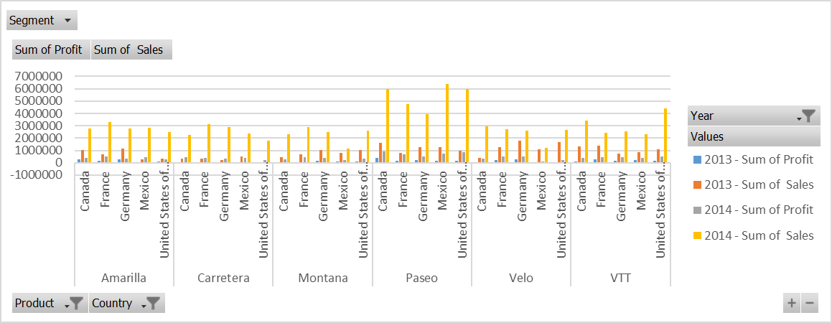
Data Exploration
This below graph shows the year wise sales and profit of all the product across of country and segments

Slide 4
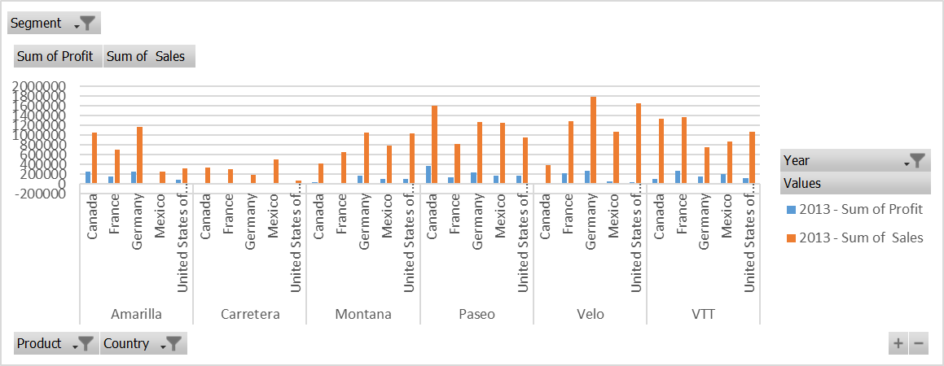
Statistical Analysis using Excel
Year 2013-
Velo has the highest sales across all segment in Germany
Paseo has the highest profit across all segment in Canada
We have loss for Carretera in France
Small business has the highest sales- if we consider segment wise sales – for Velo in USA
Government sector profit is high - if we consider segment wise profit – for Paseo in Canada
Enterprise segment is mostly in loss we need to focus on this segment.

Slide 5
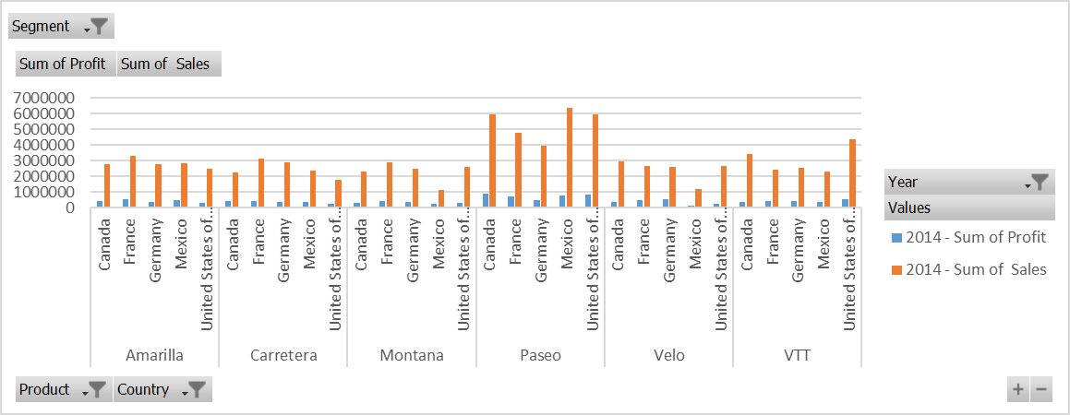
Graphical Analysis using Excel
Year 2014-
Paseo has the highest sales across all segment in Maxico
Paseo has the highest profit across all segments in Canada
There is No overall loss in 2014 – Good Sign
Small Business has highest sales -if we consider segment wise sales – for Paseo in USA
Government has highest profit -if we consider segment wise profit – for Paseo in Canada
Segment wise Enterprise is still in loss

Slide 6
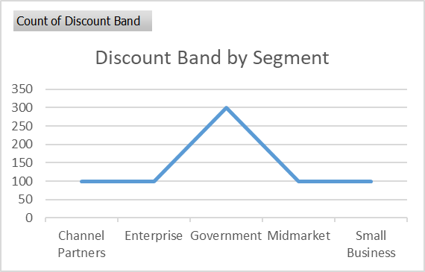
Graphical Analysis using Excel
Overall –
2014 has the highest sales and profit as compared to 2013 across all segment, all product and all country.
We can observe Small business are doing much sales in both 2013 and 2014 but the profit earned by Government sector is much hight because of the amount of discount the Government sector can afford
Overall observation only shows France has loss in 2013
Segment wise observation says that Enterprise is in continuous loss for both 2013 and 2014, some steps needs to be taken to analyse the loopholes

Slide 7
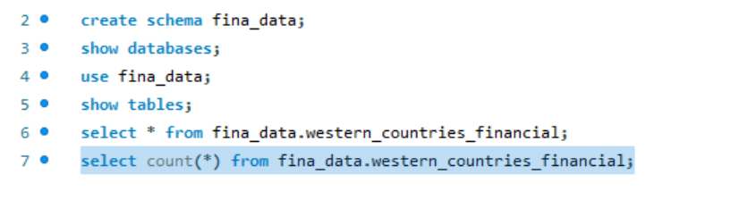
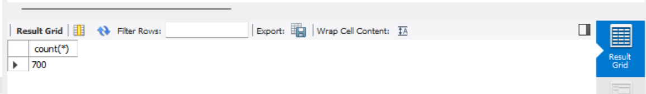
Insert the given data into the SQL server
Data is inserted successfully in the MySQL workbench under schema fina_data-

Slide 8
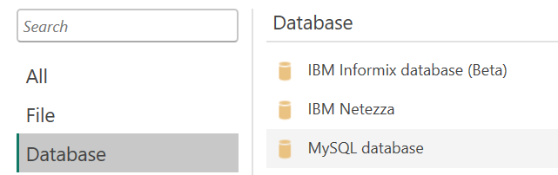
Import the Data from the SQL Database into PowerBI
Imported the data from MySQL database to power BI –
Server name – localhost:3306
Database – fina_data
User – root
Password - ****
Count is verified – 700
Data is filtered

Slide 9
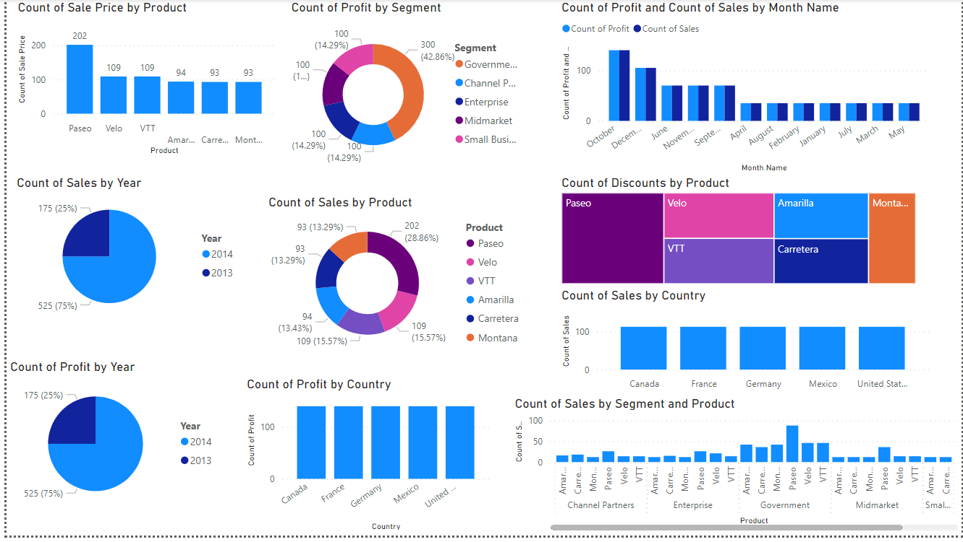
Interactive Dashboard by using visualization tools
Below is the Dashboard from Power BI-

Slide 10
Conclusion and Inferences
Below are the few conclusion from the dashboard-
Paseo is sold highest – if compared product wise sales
Government sector has earned the highest profit
In 2014 the sales and profit is high as compared to 2013
Discount offered on Paseo was highest as compared to other products

Slide 11
Endnotes
Reference Links:-
Excel file –
Power BI -

